Slide 1
Review Analyzing 2
Aaron Zhao

Slide 2
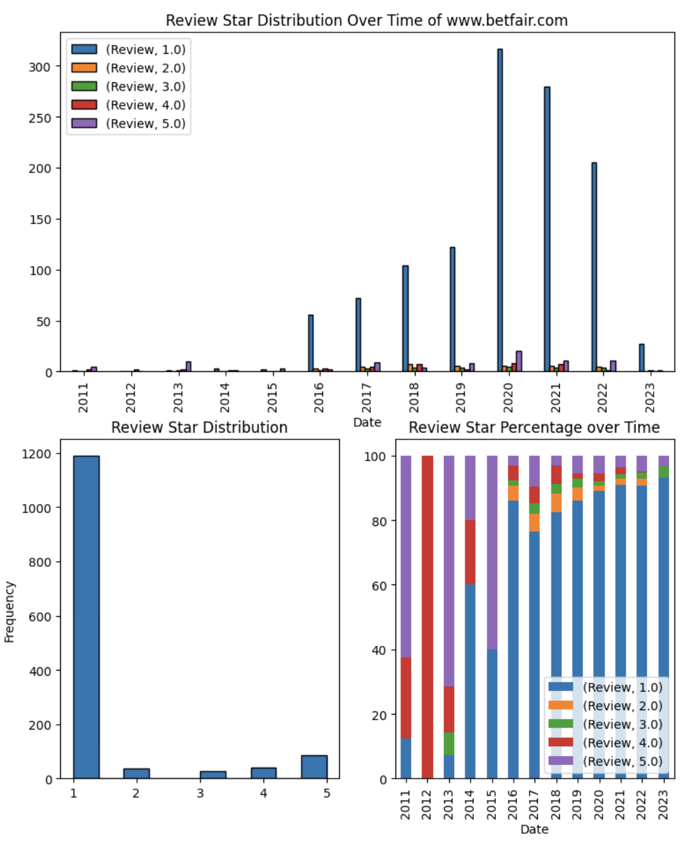
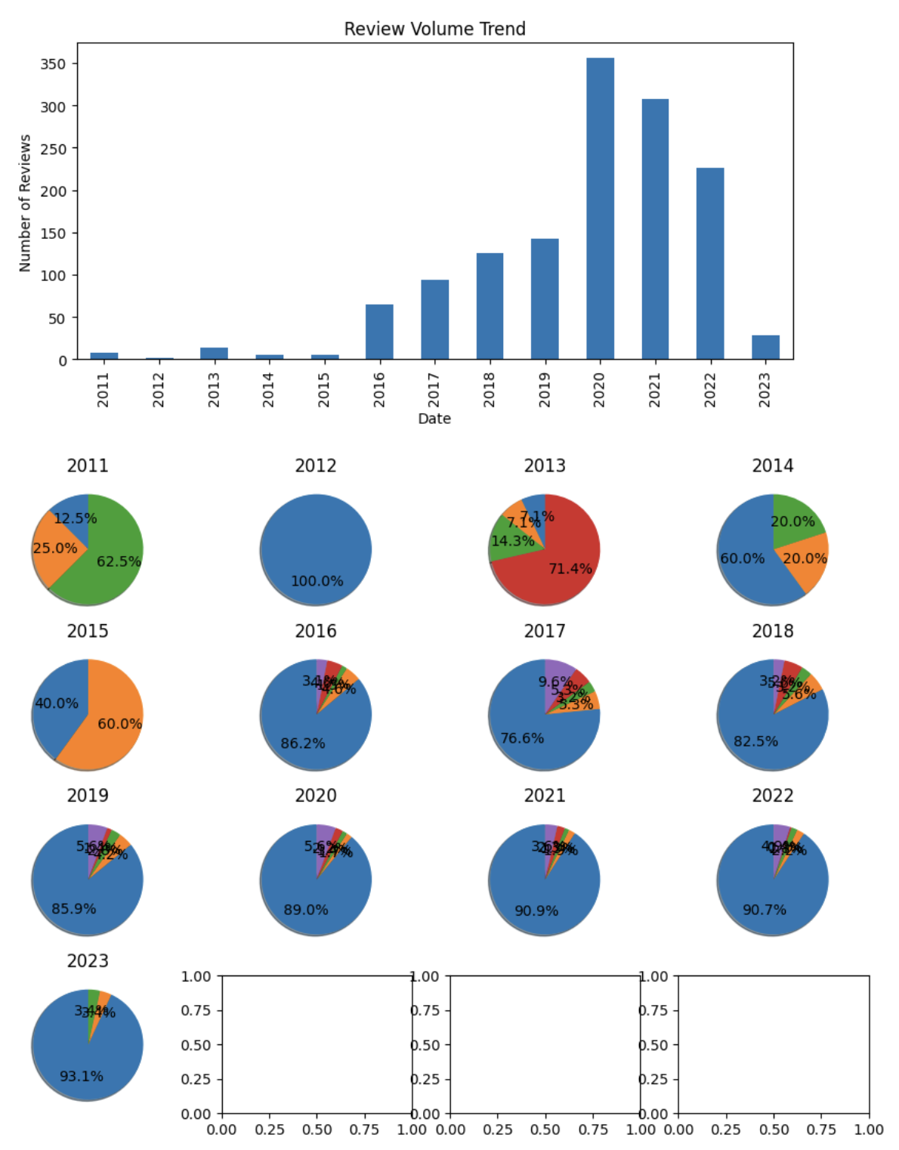
CASE 2 | BRIEF ANALYSIS
www.betfair.com

Slide 3
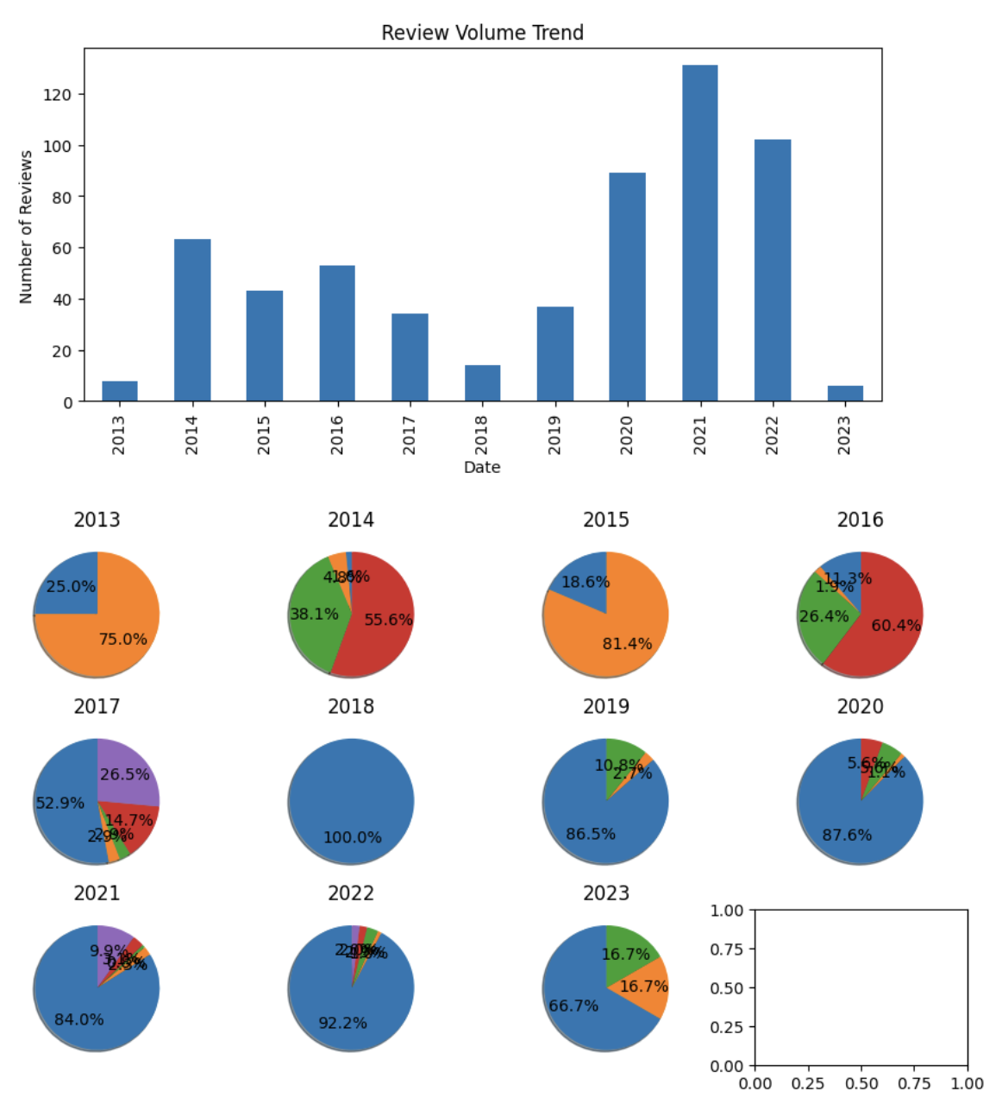
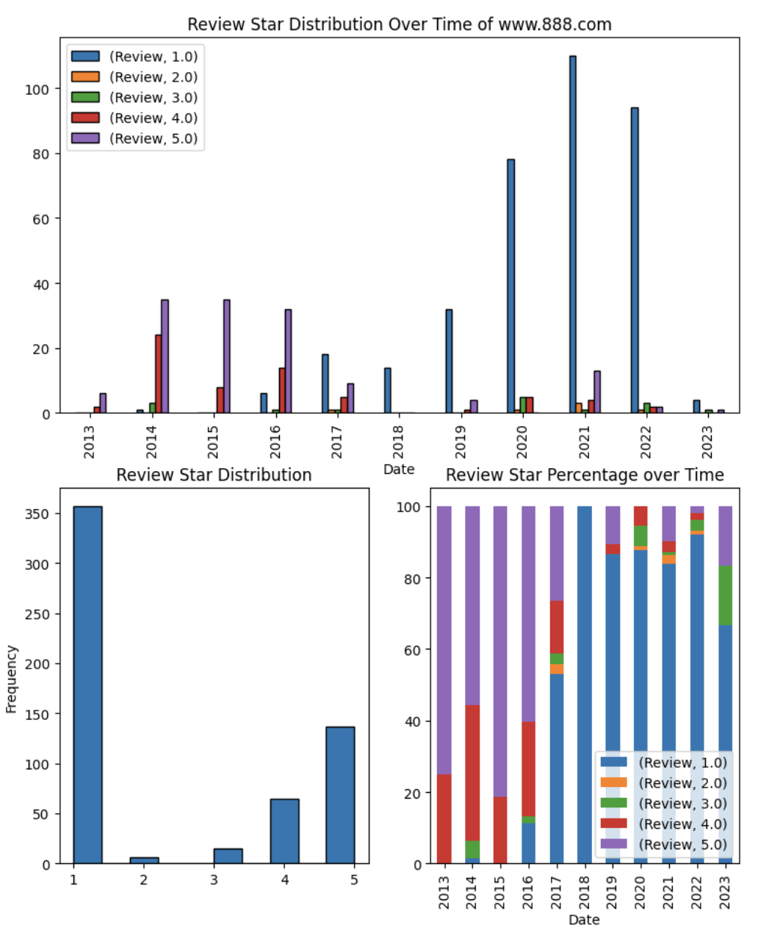
CASE 2 | BRIEF ANALYSIS
www.888.com

Slide 4
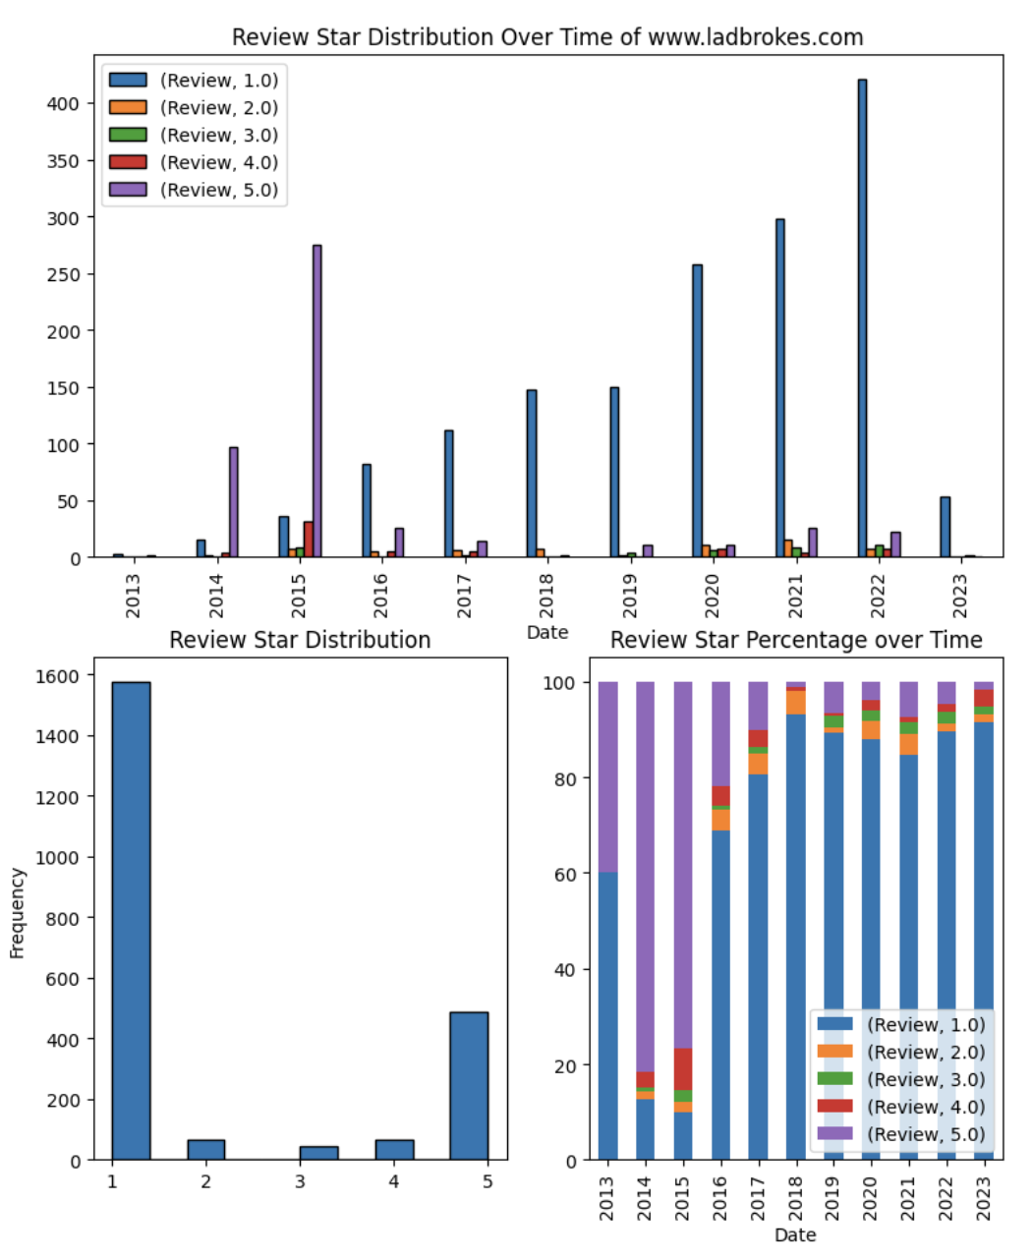
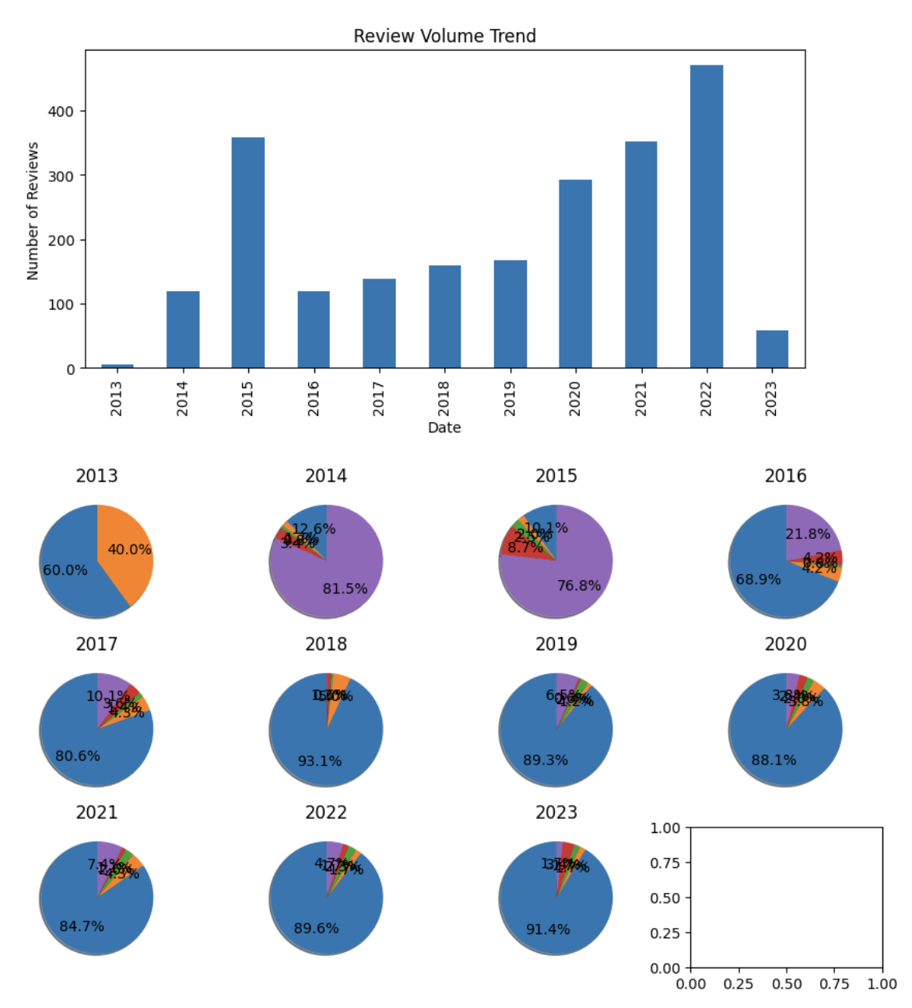
CASE 2 | BRIEF ANALYSIS
www.ladbrokes.com

Slide 5
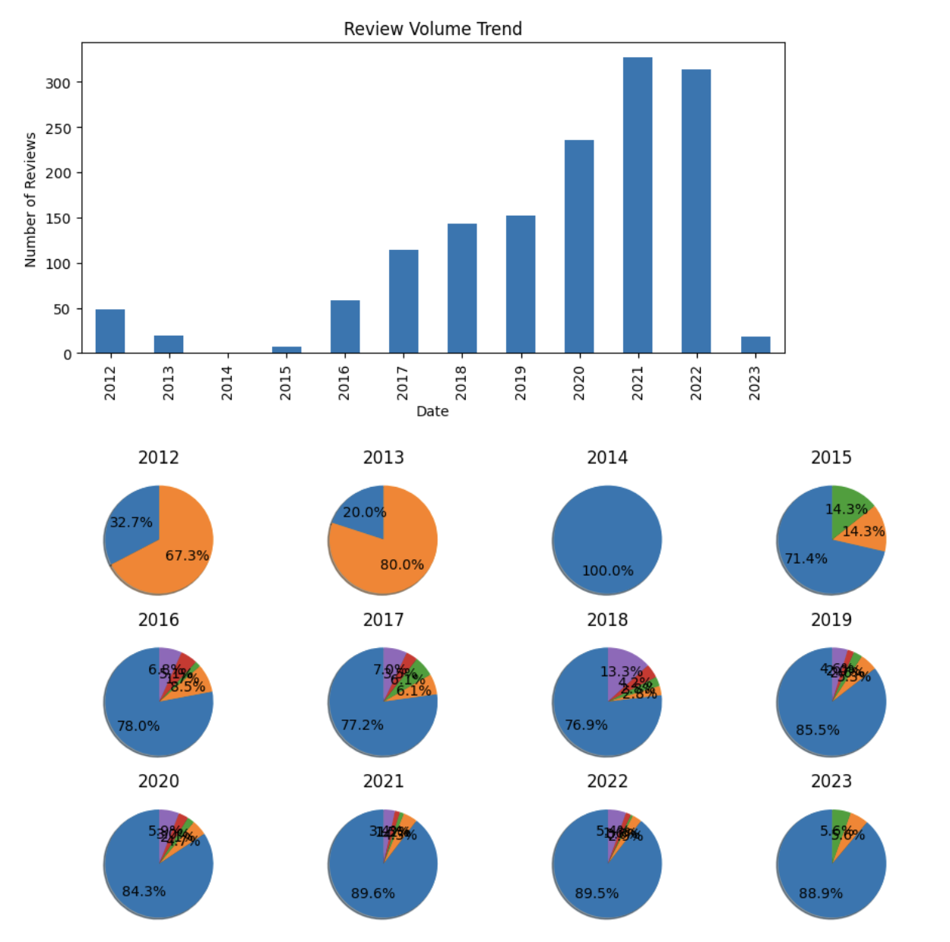
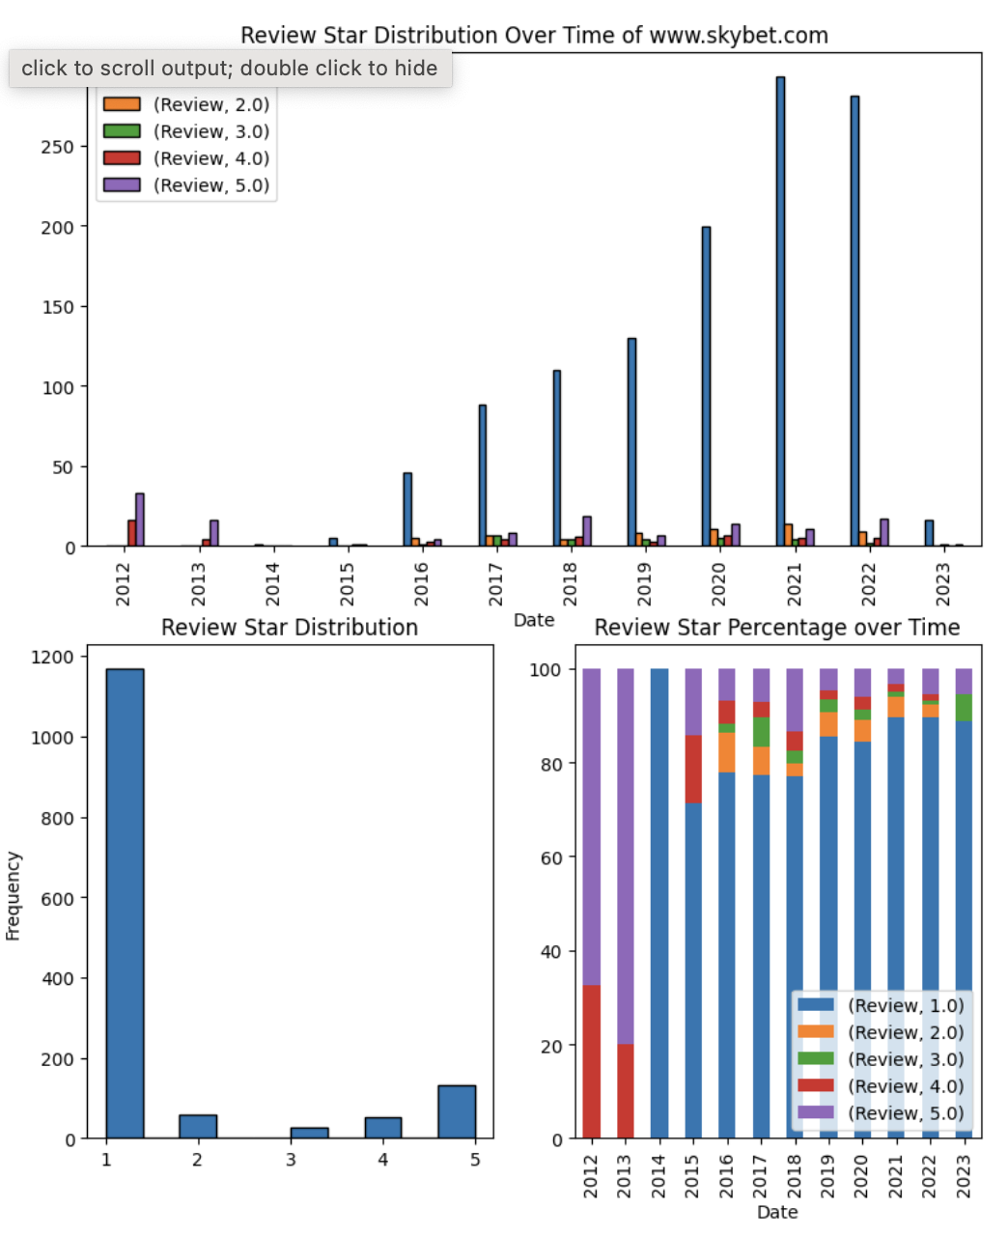
CASE 2 | BRIEF ANALYSIS
www.skybet.com

Slide 6
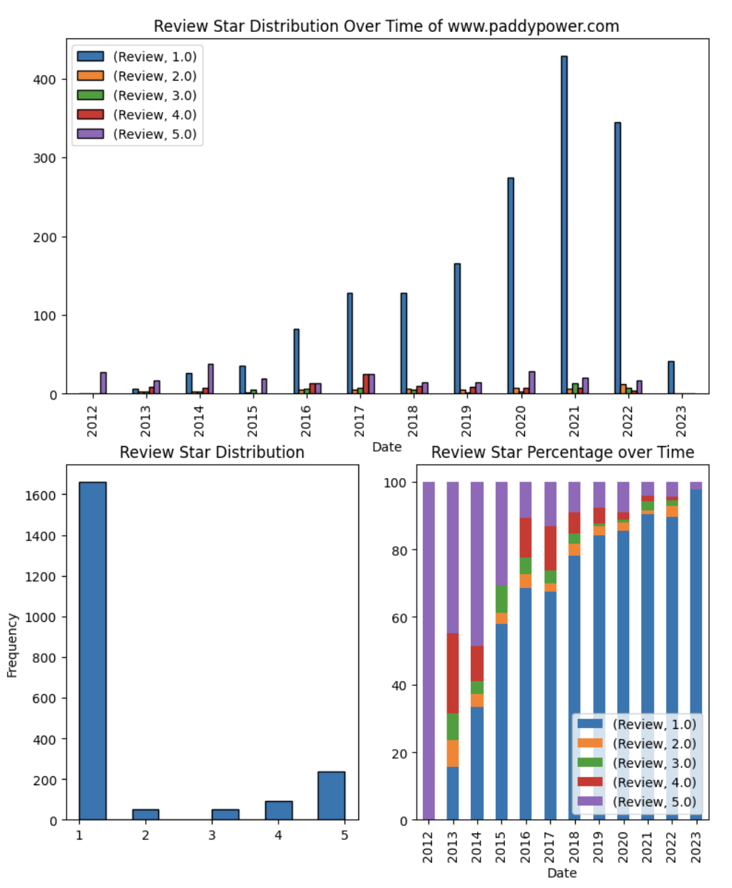
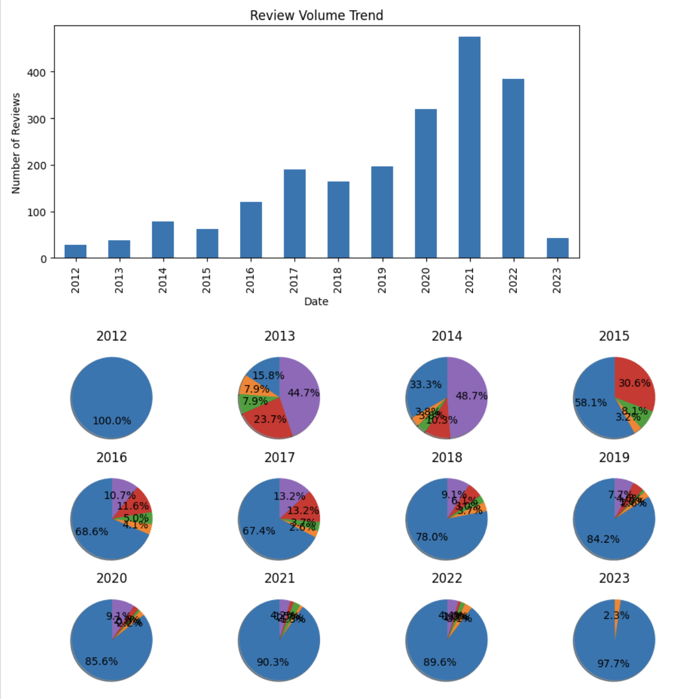
CASE 2 | BRIEF ANALYSIS
www.paddypower.com

Slide 7
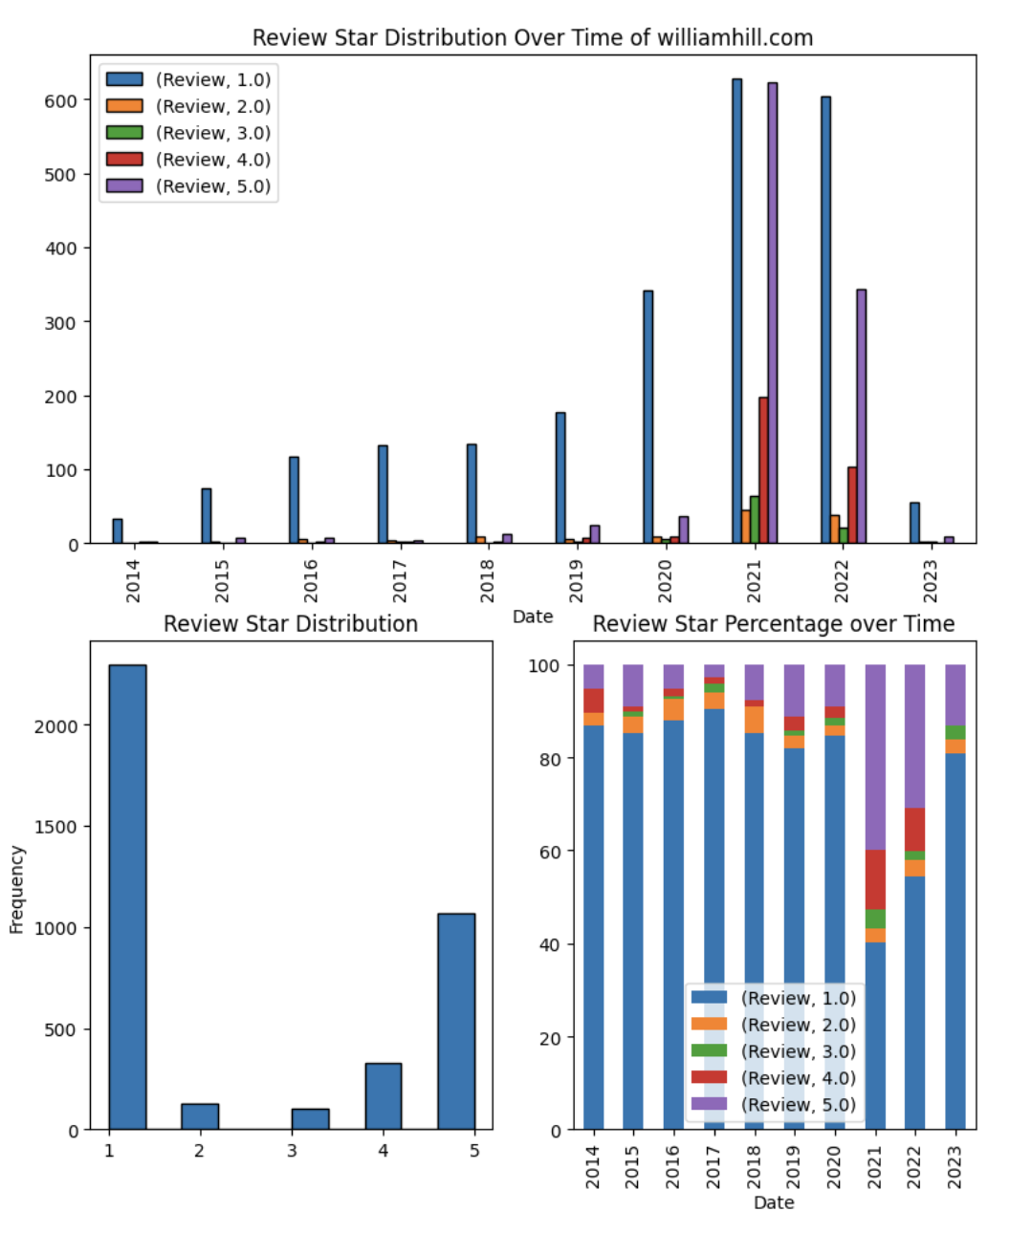
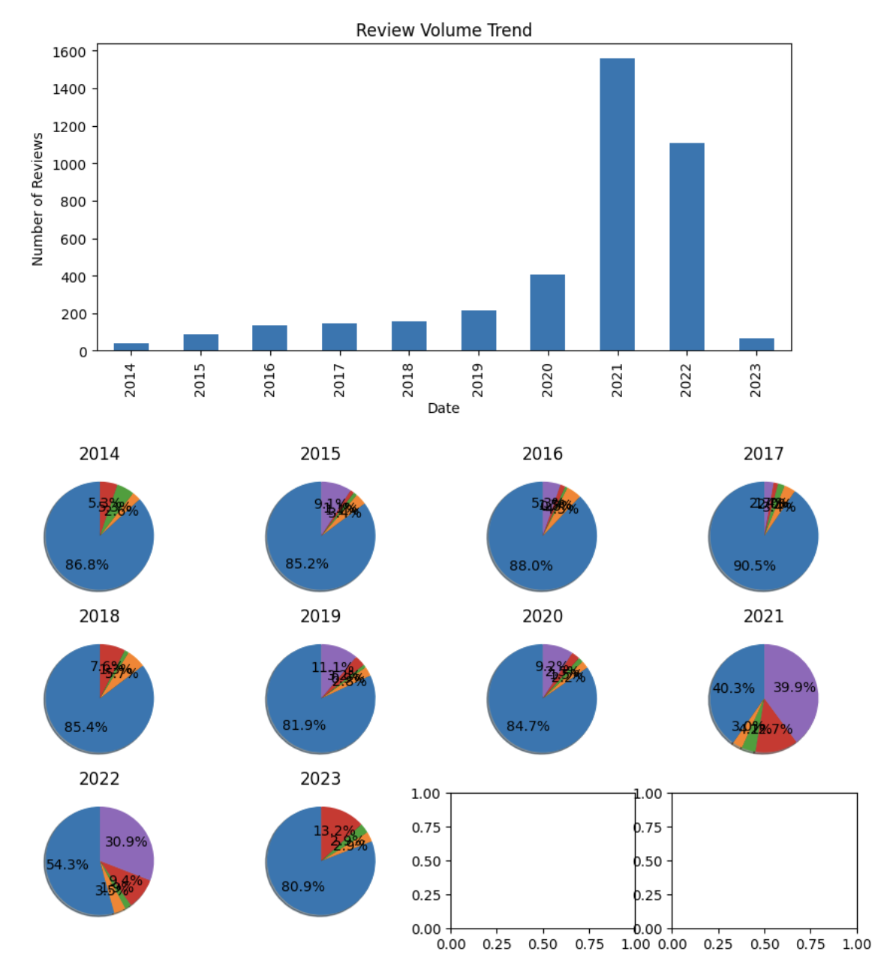
CASE 2 | BRIEF ANALYSIS
williamhill.com

Slide 8
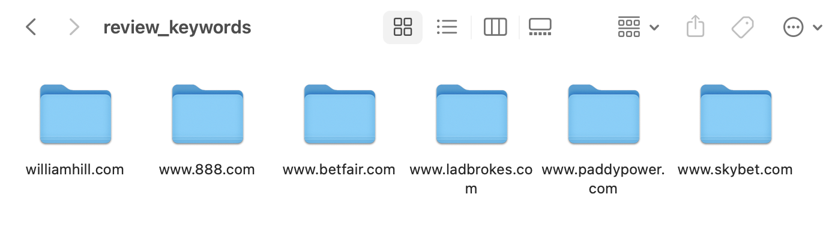
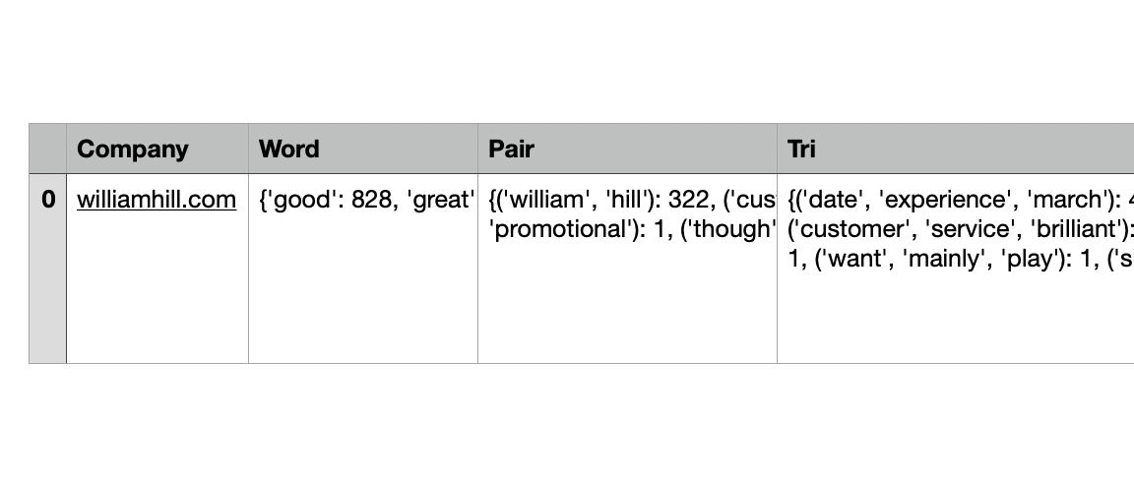
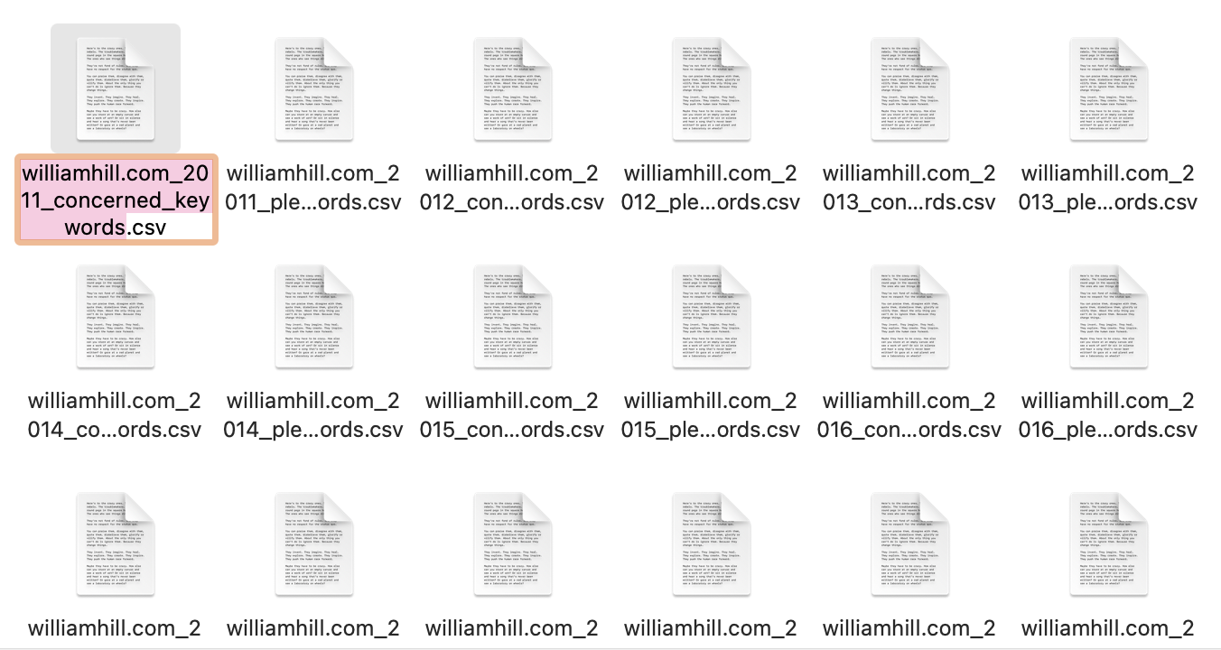
CASE 2 | BRIEF ANALYSIS
High-frequency keywords of different companies were also extracted based on the rate (1-5) and year (2011-2023) in order to know what exactly excites and what frustrated the players. Also, an overall file was also created containing all keywords of all the reviews in 10-year span. They are all categorized into folders by their name.

Slide 9
CASE 2 | BRIEF ANALYSIS
williamhill.com (Concerned)
Words are also analyzed based on the companies and the time span.
Take Williamhill as an example, players started leave comments from 2014, the things they concerned about the most in the first beginning years (2015, 2016) were ‘’postill”, “account”, “money”, “customer service”, “close account”, “deal request”, “live chat”, and “trevor postill”.
Without surprise, the top three things they mentioned the most in 2017, 2018, 2019 were still “account”, “money”, and “bet” (I took “William” and “hill” out since it’s the company’s name). The reason behind was while gambling online, your account was not only your property but also a tool or a platform that you can make or lose money. Since the security of account is very important, the customers tended to concerned more about money, account and customer service since the customer service is the only method that any customer can user to contact with someone working in Williamhill.
We didn’t see major changes in the topics that players concerned the most while going through their most mentioned words. However, it did catch my eyes that SCAM became a newly keyword in 2021. After complaining about the account, money for a few years, players have a tendency to see Williamhill as a scam. Without surprise, one of the most mentioned three-words is “get money back”. People started to lose confidence in Williamhill and planned quitting and withdrawing their money.

Slide 10
CASE 2 | BRIEF ANALYSIS
williamhill.com (Pleased)
The things they are pleased with the most in the first beginning years (2015, 2016) were “account”, “money”, “customer service”, “receive money”, “get money”, and “live chat”. We can see overlapped words in both Pleased and Concerned, which means the customer service at that time was unstable and lack consistency. Also, we can see a strong conflict between the Pleased words in 2015 -2016 and 2019-2022. People got their money back in the first few years but started to come across glitch or problems in getting their money back in 2019-2022
People kept being happy about winning and getting their money back in 2017-2019. They described WilliamHill as the ‘best site’ and ‘decent bookmaker’ because it was ‘easy to payout’. People were pleased with the new available games and the promotions.
Surprisingly, since 2021, people started to compromised the date experience and it took almost the half of the keywords mentioned. Devising new strategies made the number of reviews of williamhill’s experienced an exponentially increase. It increased the volume of WilliamHill’s reviews for more than 4 times from 400 to 1600.

